Slide 1
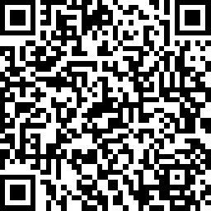


Expression of Interest for
Consumer Involvement in Research
Project title
Researcher: Your name, Role, Department/Org Unit, Facility
Project overview
In about 100 words describe, in plain English, the problem that your project is trying to address. If it is part of the problem, acknowledge that previous research in the area has not involved people with lived experience. Outline what you are proposing to do next and how you think this will address the problem. It may not be possible to say exactly what you are hoping to do (because you will shape this with consumer input), but you might suggest some possible elements that you already have in mind.
Consumer involvement opportunities
In about 200 words, describe in plain English, what kind of consumer involvement you are seeking. Be clear about who you are looking for, the duration of the project, the time commitment from consumers, and any remuneration offered.
Project Number for Expression of Interest
Scan the QR Code to get in touch with the researcher about consumer involvement on this project. Express your interest to be involved in this project by scanning the QR Code or completing the EOI form at: www.surveymonkey.com/r/rbwhresearch. Alternatively, please email the research team directly at: [email address]
XX

